Slide 1
Technical Updates
Humayun Kabir, Sr. Principal Surveyor
February 07, 2026

Slide 2
Agenda
SOLAS Lifting Appliances (SLA)
Anchor Handling Winches (AHW)
Prohibition of use of Fire Fighting Foams containing PFOS
Emergency Power Supply Requirements
Steering Gear Room Safety
PSC Deficiencies

Slide 3
Safety Moment

Slide 4
SOLAS Lifting Appliances
Regulation II-1/3-13, introduces a requirement for survey and certification of onboard
To be certified on or after 01 January 2026 for:
  SOALS Lifting Appliances (SLA) and
  Anchor Handling Winches(AHW); abbreviated as OLAW
SLA installed on/or after 01 January 2026 shall be designed, constructed and installed in accordance with class society requirements or standards acceptable to the Administration.
SLA installed before 01 January 2026 with valid certification, shall be tested, thoroughly examined not later than the first renewal safety construction survey or renewal safety passenger survey (carried out annually) on or after 01 January 2026.
SLA in general applies to the vessel and equipment used by the crew.
The regulation does not define whether it covers the ILO 152 (used for stevedores),
The IACS Cargo Gear Certification will continue to comply (ILO & non-ILO) for existing ships.
This includes Loose Gears (LG). The LGs’ are equipment by means of which a load can be attached to a lifting appliances but does not form an integral part of appliances or load.

Slide 5
SOLAS Lifting Appliances
The regulation applies to load-handling ship’s equipment that are used for:
Cargo loading, transfer, or discharge
Raising and lowering hold hatch covers or movable bulkheads
Engine-room cranes
Stores cranes
Hose handling cranes
Launch and recovery of tender boats and similar applications
Personnel handling cranes
Additionally applies to:
Any lifting appliance that is permanently connected to the ship (by welding or bolting) or permanently travel on fixed rails onboard. Examples can be engine room monorail trolleys with hoist (when permanently installed) and lifting platforms for cargo or personnel.
Car ramps and movable decks when these are operated with cargo on them,
Lifting Appliances with a safe working load (SWL) less than 1,000 Kgs (1 Ton); this applicability has been left to individual flag Administration to determine,
Dual purpose appliances; that are intended to serve as launching appliance for survival craft or rescue boat and as lifting appliance for SOLAS provided that such equipment complies in full with,
  SOLAS Ch. III and LSA Code
  SOLAS Ch. II-1/Reg. 3-13 and MSC.1/Circ. 1663
  and is certified for dual use.
The regulation does not apply to:
Lifting appliances certified as MODUs
Lifting appliances used on offshore construction (OCV) ships,
Integrated mechanical equipment for opening and closing hold hatch covers
Life-saving launching appliances complying with the International Life-Saving Appliances (LSA) Code
Elevators
Ship’s anchor windlasses
References:
SOLAS
MSC. 532(107)
MSC.1/ Circ.1663, Guideline
UI SC310

Slide 6
Anchor Handling Winches
SOLAS Regulation II-1/2-31, 32, 33 and II-1/3-13, require on board Anchor Handling Winches (AHW) shall be certified on or after 01 January 2026.
AHW shall be designed, constructed and installed on or after 01 January 2026 IAW class society requirements or standards accepted to the Administration.
AHW installed before 01 January 2026 shall be tested and thoroughly examined, no later than the first renewal safety construction survey/ renewal safety passenger survey (carried out annually) on or after 01 January 2026
This includes Loose Gears (LG). The LGs’ are equipment by means of which a load can be attached to an AHW, but does not form an integral part of appliances or load.
Note: These anchor handling winches typically handle anchors and mooring lines that belong to other vessels, and not the vessel on which the anchor handling winch is installed. Hence this should not be misrepresented with the vessel’s anchor windlasses.
References:
SOLAS II-1/3-13
MSC. 532(107)
MSC.1/ Circ.1662, Guideline

Slide 7
Prohibition of use of Fire-Fighting Foams containing PFOS
Effective 01 January 2026, the use of fire-fighting foams containing PFOS (perfluorooctane sulfonic acid) is prohibited onboard ships due to their toxic nature.
Applicable for both fixed and portable systems and includes all existing media that contain PFOS and can be used in the fire extinguishing equipment
New ships are to comply with the keel laying date. Existing ships, this is applicable at the first annual, periodical or renewal safety equipment survey whichever comes first
The phrase "containing perfluorooctane sulfonic acid (PFOS)" should mean present in concentrations of PFOS above 10 mg/kg (0.001% by weight).
Existing media containing PFOS are not to be stored on ships,
The Administration or its recognized organization to review the maker's declaration or laboratory test
The declaration issued by the foam maker should contain information about the foam such as, but not limited to: foam type, production period, batch No., ref. to type approval / MED Certificate for the foam.
References:
SOLAS reference MSC. 532(107), MSC(107), MSC.537 (107)
MSC/Circ.670 - Guidelines for the performance and testing criteria and surveys of high-expansion foam concentrations for fixed fire extinguishing. systems.
MSC.1/Circ.1312, revised guidelines for the performance and testing criteria, and surveys of foam concentrations for fixed fire-extinguishing systems.

Slide 8
EPS Testing - Safety Bulletin by Tokyo MOU
As reported by Port State Control Officers, alarming number of ships were unable to demonstrate a satisfactory test of Emergency Power Supply.
When using a “Sequential Test” method or using a “Routine Test Switch” (RTS); it was able to start satisfactorily (as shown below).
Reference - Picture source is from Tokyo MOU –Safety Bulletin (04/2024) - July 2024

Slide 9
EPS Testing - Safety Bulletin by Tokyo MOU
It gives ships’ engineers a false sense of readiness of the ships’ emergency systems.
When tested by opening the main switch board (MSB) Bus Tie (for a controlled blackout), the emergency generator was unable to:
  automatically start, or
  provide transitional source of power, or
  automatically connect to the emergency switch board.
It is identified that during a “controlled blackout” test, a different logic is performed than carrying out a “Sequential Test” and/or RTS.
The actual circuit, relays, and printed circuit boards when used in a real situation are not tested during routine maintenance.

Slide 10
EPS Testing - Safety Bulletin by Tokyo MOU
Recommendation to Management Companies
“Sequential Test” selector and/or “Routine Test Switch” (RTS), to be designed that circuit is wired such a way that for the purpose of testing, actual circuit paths are used to test the system.
SMS should include periodic “Controlled Blackout Tests” to ensure the actual circuit path is used as required during an active scenario.
Ensure that “Sequential Test” selector and/or “Routine Test Switch” (RTS) meet the requirements of SOLAS II-1 Reg 42.5.4/43.5.4 as follows:
  The emergency switchboard shall be supplied during normal operation from the main switchboard by an interconnector feeder which is to be adequately protected at the main switchboard against overload and short circuit, and
  It is to be disconnected automatically at the emergency switchboard upon failure of the main source of electrical power.
IACS Concentrated Inspection (CIC) has ended end of December 2025.

Slide 11
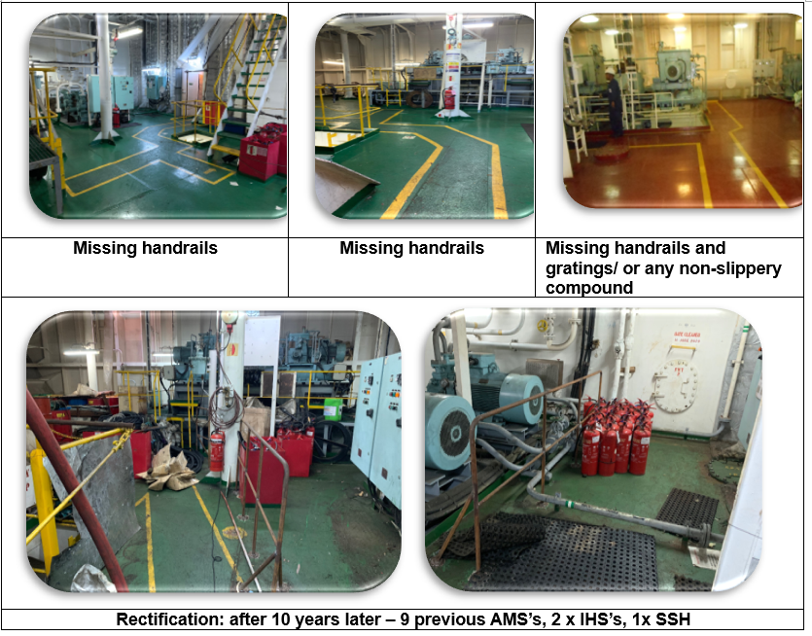
STEERING GEAR COMPARTMENT
Reference: MVR 4-3-4/1.7 and SOLAS II-1/29.13
The steering gear compartment shall be provided with suitable arrangements to ensure working access to steering gear machinery and controls. Theses arrangements shall include handrails and gratings or other nonslip surfaces to ensure suitable working conditions in the event of hydraulic fluid leakage.

Slide 12
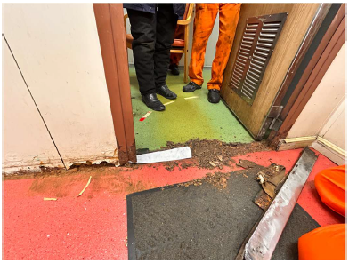
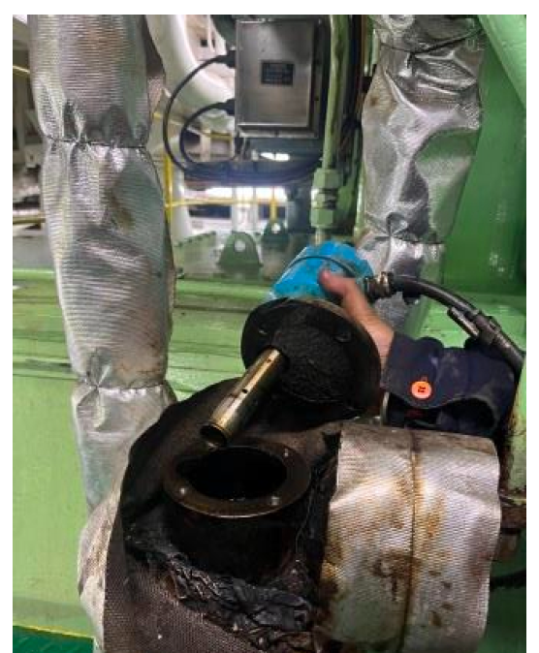
Representative Deficiencies
Crew mess room entrance door sill (Class –B fire door) and bulkhead panel next lower part wasted. Fire boundary integrity lost.
ME FO leak-off alarm bypassed. Sensor was removed from the alarm assembly.

Slide 13
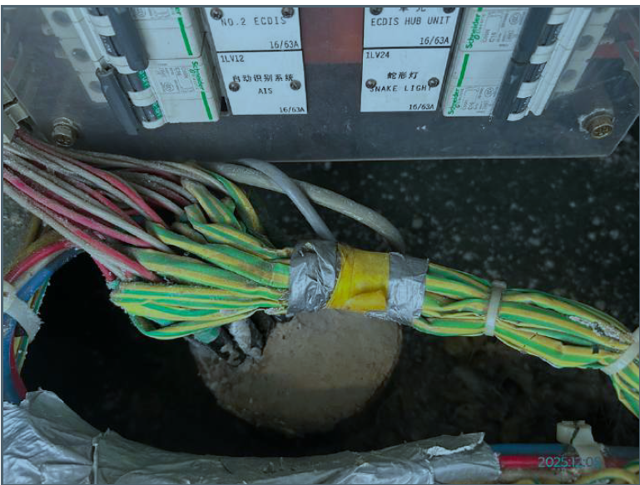
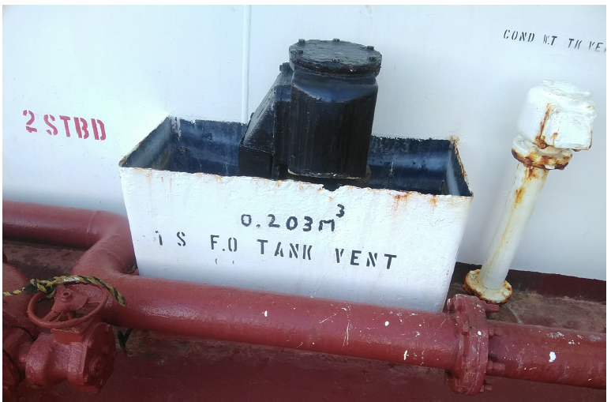
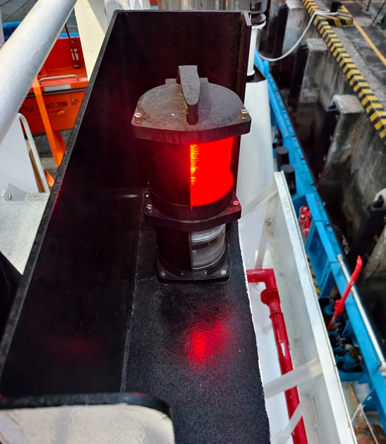
Representative Deficiencies
Both light arc of port (red) and starboard (green) sidelights are not compliant with COLREG requirement from ahead to after beam 22.5 degree. The sidelights should be visible from directly ahead to slightly behind the vessel’s sides (22.5 degrees abaft the beam).
The wiring for the ECDIS penetration from the bridge to accommodation spaces is not properly sealed with insulation materials.
Save all tray edges thinned and corrosion persists

Slide 14
Thank You

